Slide 1
Efficient processing of complex highly selective queries over large datasets
There and back again
Dr Nikos Ntarmos
nikos.ntarmos@huawei.com
nikos.ntarmos@glasgow.ac.uk
https://ntarmos.info/

Slide 2






Slide 3
Outline
Needle in a (big data) haystack
  Rank-joins
  k-nearest-neighbours
  Subgraph matching
Database systems research @ Huawei ERC

Slide 4
Ouroboros…

Slide 5








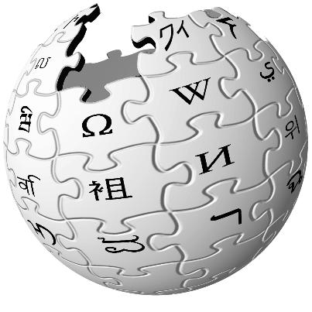
Big Data hype!

Slide 6
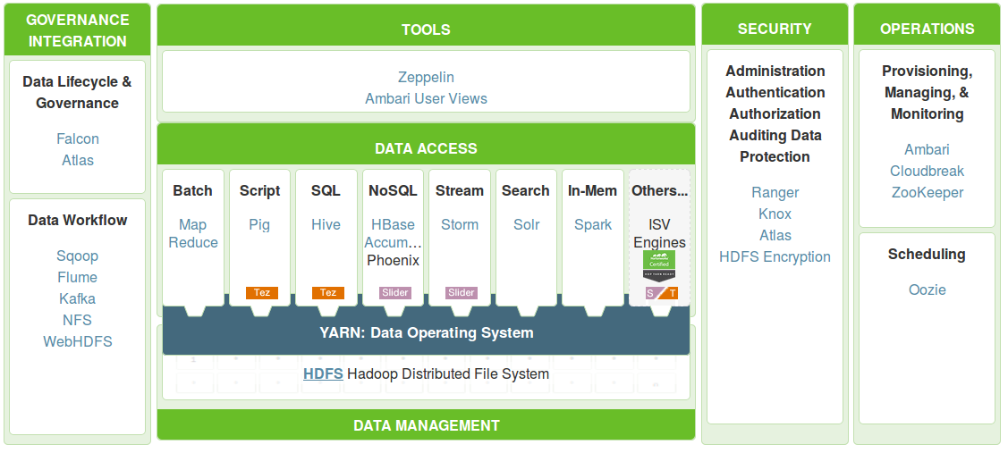
Enter Hadoop and friends…
Source: http://hortonworks.com/hdp/

Slide 7
There and back again…
“Big data tools” very useful
  Fault tolerant + scalable processing of tasks requiring
  (semi-)complete scans
  Fault tolerant + scalable storage “for free”
But come with design decisions that can hurt performance
  Fairly rigid map-reduce style computation
  Large units of storage to improve throughput
  Optimised for scan-everything tasks
➔ Highly selective tasks suffer
Solution:
  Distributed index building + storage
  Coordinator-based query processing

Slide 8
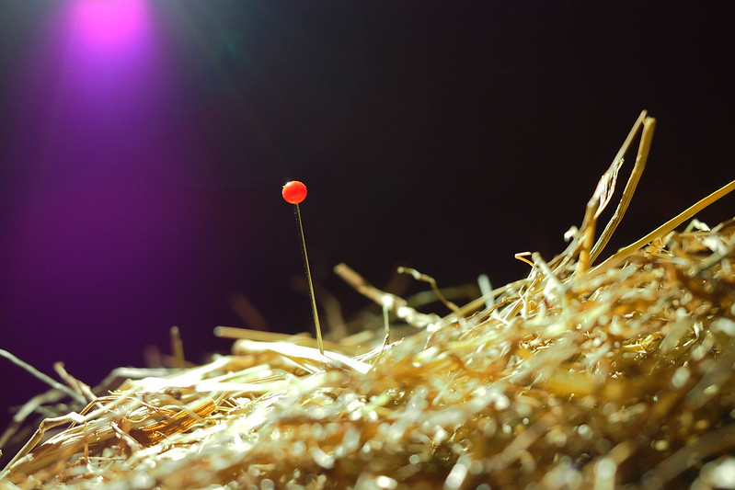
Part I: Needle in a (big data) haystack

Slide 9
Needle in a haystack
Big Data
Trash Gap
Relevant Data

Slide 10
Case study 1: Top-k Join Queries

Slide 11
Top-k Join Queries
SELECT select-list FROM R₁, R₂, …, R_{n}
WHERE join-expression(R₁, R₂, …, R_{n})
ORDER BY f(R₁, R₂, …, R_{n})
LIMIT k
Scoring of individual tuples of R_{i} based on either
  an explicit score attribute (e.g., movie viewer rating, PageRank score, ...) or
  a score function on a subset of the tuple attribute values
Score of join result tuples computed using a monotonic aggregate function f() on individual tuple scores
N. Ntarmos, I. Patlakas, and P. Triantafillou. “Rank join queries in NoSQL databases.” PVLDB, 7(7):493–504, 2014.

Slide 12
Inverted Score List Top-k Join
SELECT * FROM T1, T2 WHERE T1.A=T2.A
ORDER BY T1.Score+T2.Score STOP AFTER 1
Table 1
Score | A | TupleID | …
95 | 12 | K | …
90 | 17 | I | …
82 | 20 | J | …
Table 2
Score | A | TupleID | …
93 | 17 | K2 | …
85 | 12 | I2 | …
83 | 20 | J2 | …
Match1: A = 17, Score = 183
Match2: A = 12, Score = 180
Max future join score = max(95+85, 90+93) = 183
No unprocessed tuple can be in the result set and have a higher score than Match1

Slide 13
Not there yet…
With textbook Ilyas-style approach, tuples may still be read from disk and transferred over the network, even though they may never contribute to the join result
Goal: only the tuples needed for the final result set should be read and transferred

Slide 14
The BFHM structure
Equi-width histogram on score values
Each bucket stores:
  The min and max score for its existing tuples
  A Bloom filter (*) of tuple join attribute values
(*) Actual data structure is a Golomb-compressed hybrid of a 1-hash Plain BF, plus
a hashtable of non-zero Counting BF counters…

Slide 15
BFHM example
BFHM for T1
T1
T2
 | 0.9-1 | 0.8-0.9 | 0.7-0.8 | 0.6-0.7 | 0.5-0.6
h(C)
h(A)
h(D)
h(B)
Join key | Score | Join key | Score
A | 1.00 | B | 0.92
C | 0.93 | B | 0.91
B | 0.82 | C | 0.64
D | 0.82 | D | 0.53
D | 0.82 | A | 0.51
C | 0.79 | D | 0.50
A | 0.73 | D | 0.41
B | 0.70 | A | 0.38
D | 0.68 | A | 0.37
C | 0.67 | A | 0.35
B | 0.64 | C | 0.31
1
1
1
A 1.00
1
1
C 0.93
B 0.82
1
1
2
D 0.82
D 0.82
1
1
1
C 0.79
BFHM for T2
 | 0.9-1 | 0.6-0.7 | 0.5-0.6 | 0.4-0.5 | 0.3-0.4
h( C) |  | 1 |  |  | 1
h(A) |  |  | 1 |  | 3
h(D) |  |  | 2 | 1
h(B) | 2
A 0.73
B 0.70
D 0.68
C 0.67
B 0.64

Slide 16
Result estimation using BFHMs
 | 0.9-1 | 0.8-0.9 | 0.7-0.8 | 0.6-0.7 | 0.5-0.6
h(C) | 1 |  | 1 | 1
h(A) | 1 |  | 1
h(D) |  | 2 |  | 1
h(B) |  | 1 | 1 | 1
Idea:
  Compute a “bit-wise product” of BFHM buckets in pairs
    If the product is >0 then there are possible result(s)
  Produce a list of estimated results sorted on their attainable scores
 | 0.9-1 | 0.6-0.7 | 0.5-0.6 | 0.4-0.5 | 0.3-0.4
h(C) |  | 1 |  |  | 1
h(A) |  |  | 1 |  | 3
h(D) |  |  | 2 | 1
h(B) | 2
Join Attr | Min Score | Max Score | # of results | T1 bucket | T2 bucket
h(C) | 1.5 | 1.7 | 1 | 0.9-1 | 0.6-0.7
h(A) | 1.4 | 1.6 | 1 | 0.9-1 | 0.5-0.6
h(C) | 1.2 | 1.4 | 1 | 0.9-1 | 0.3-0.4
h(A) | 1.2 | 1.4 | 3 | 0.9-1 | 0.3-0.4

Slide 17
Result estimation using BFHMs (cont.)
Join Attr | Min Score | Max Score | # of results | R1 bucket | R2 bucket
h(B) | 1.7 | 1.9 | 2 | 0.8-0.9 | 0.9-1
h(B) | 1.6 | 1.8 | 2 | 0.7-0.8 | 0.9-1
h(c) | 1.5 | 1.7 | 1 | 0.9-1 | 0.6-0.7
h(B) | 1.5 | 1.7 | 2 | 0.6-0.7 | 0.9-1
h(A) | 1.4 | 1.6 | 1 | 0.9-1 | 0.5-0.6
h(C) | 1.3 | 1.5 | 1 | 0.7-0.8 | 0.6-0.7
h(D) | 1.3 | 1.5 | 4 | 0.8-0.9 | 0.5-0.6
h(C) | 1.2 | 1.4 | 1 | 0.9-1 | 0.3-0.4
h(A) | 1.2 | 1.4 | 3 | 0.9-1 | 0.3-0.4
h(A) | 1.2 | 1.4 | 1 | 0.7-0.8 | 0.5-0.6
Top-5 query
h(B) | 1.7 | 1.9 | 2 | 0.8-0.9 | 0.9-1
h(B) | 1.6 | 1.8 | 2 | 0.7-0.8 | 0.9-1
h(C) | 1.5 | 1.7 | 1 | 0.9-1 | 0.6-0.7
Top-5 estimated result tuples
h(C) | 1.5 | 1.7 | 1 | 0.9-1 | 0.6-0.7
h(B) | 1.5 | 1.7 | 2 | 0.6-0.7 | 0.9-1
h(A) | 1.4 | 1.6 | 1 | 0.9-1 | 0.5-0.6
Tuples that could be in top-k
if our estimations were off
(i.e. those with max score larger
than the min score of the k’th
result in the top-k list)

Slide 18
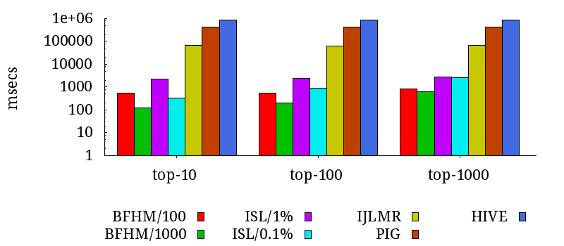
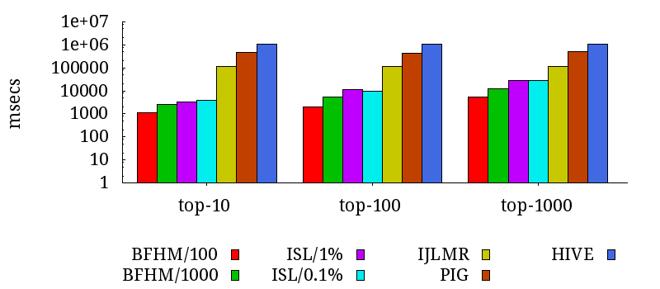
Performance Results
LineItem-Part
LineItem-Orders

Slide 19
Case study 2: k-Nearest-Neighbours

Slide 20
k-Nearest-Neighbours
SELECT * FROM R
ORDER BY distance(q)
LIMIT k
Database of multi-dimensional data points (plus properties)
User provides (multi-dimensional) query point q
Scoring of individual tuples of R based on distance from q
Cahsai, N. Ntarmos, C. Anagnostopoulos, and P. Triantafillou, “Scaling k-Nearest Neighbors Queries (The right way),” in Proceedings of the 37th IEEE International Conference on Distributed Computing Systems (ICDCS), 2017.
A. Cahsai, C. S. Anagnostopoulos, N. Ntarmos, and P. Triantafillou, “Revisiting Exact kNN Query Processing with Probabilistic Data Space Transformations,” in Proceedings of the IEEE International Conference on Big Data (BigData) (Best Student Paper Award), 2018.

Slide 21
Typical Workflow

Slide 22
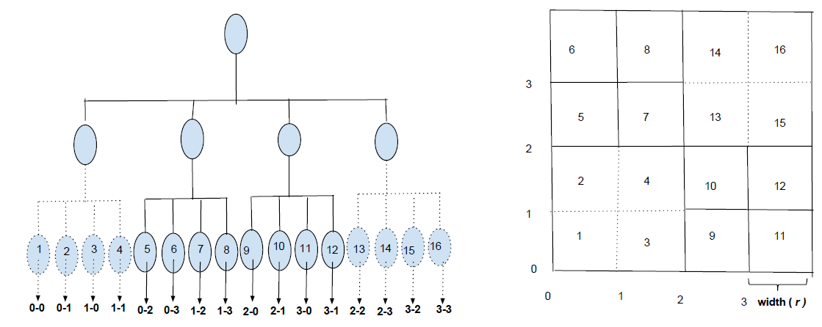
Two-pronged Solution
COWI: Coordinator With In-memory Index
  Quad-tree based index
  Sample + compute size of leaves/internal nodes to fit in main memory
  Distributed index building + storage on DFS
    Data partitioning
    Quad-tree building
  Load quad tree in coordinator’s memory + answer queries
CONI: Coordinator with No In-memory Index
  Build COWI + store in DKVS
  Build balanced Quad Tree over COWI leaf nodes
  Load only latter quad tree in coordinator’s memory + answer queries

Slide 23
Performance Results

Slide 24
What if…
If data points are uniformly distributed, a Quad Tree is an overkill
  ➔ Optimal: uniform grid
    Decide cell size based on items per cell
    Partition + store cell items together
    Only need to know cell size (along each dimension) + mapping function to cell ID
Alas, they are not
  So let’s make them be!

Slide 25
STOS: Probabilistic Space Transformation
Finite Gaussian Mixture Models to break data distribution into set of Gaussians
De-correlate per cluster RVs ➔ Remove statistical dependencies among RVs
Transform independent random RVs to joint uniform distribution
  Sklar’s theorem: any multivariate distribution can be written in terms of a univariate uniform distribution of each RV and a copula that captures the dependence between the RVs
  In independence copula, marginal and joint distributions of RVs are standard uniform
Use uniform grid to index the latter; store grid dimensions + reverse transformation function

Slide 26
Performance Results
Index Building Time
Index Loading Time
In-memory Index Size
Query Response Time
#rows accessed per query

Slide 27
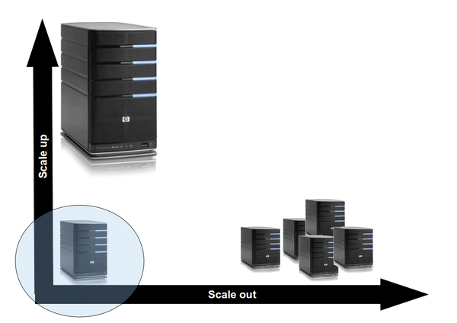
But is this the way to go?

Slide 28
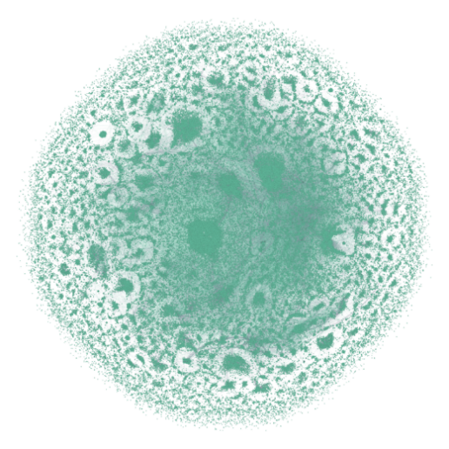
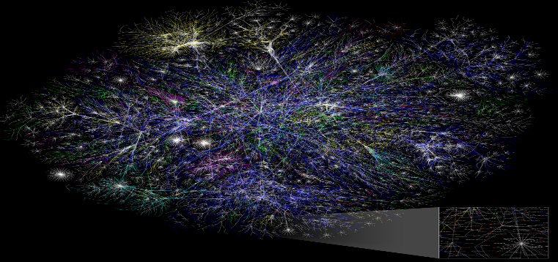
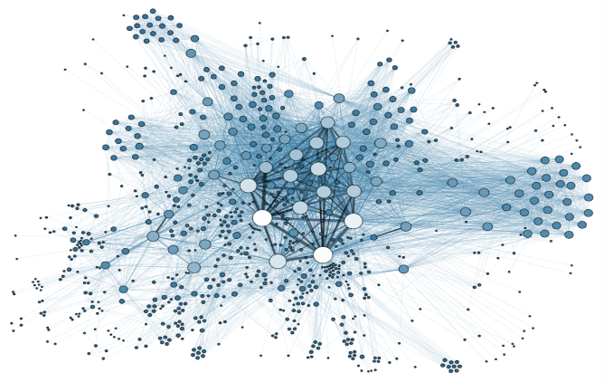
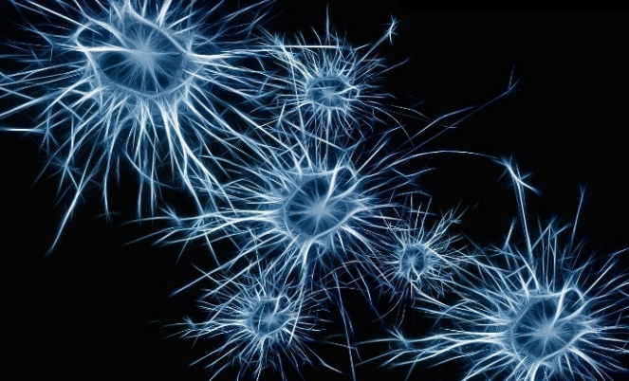
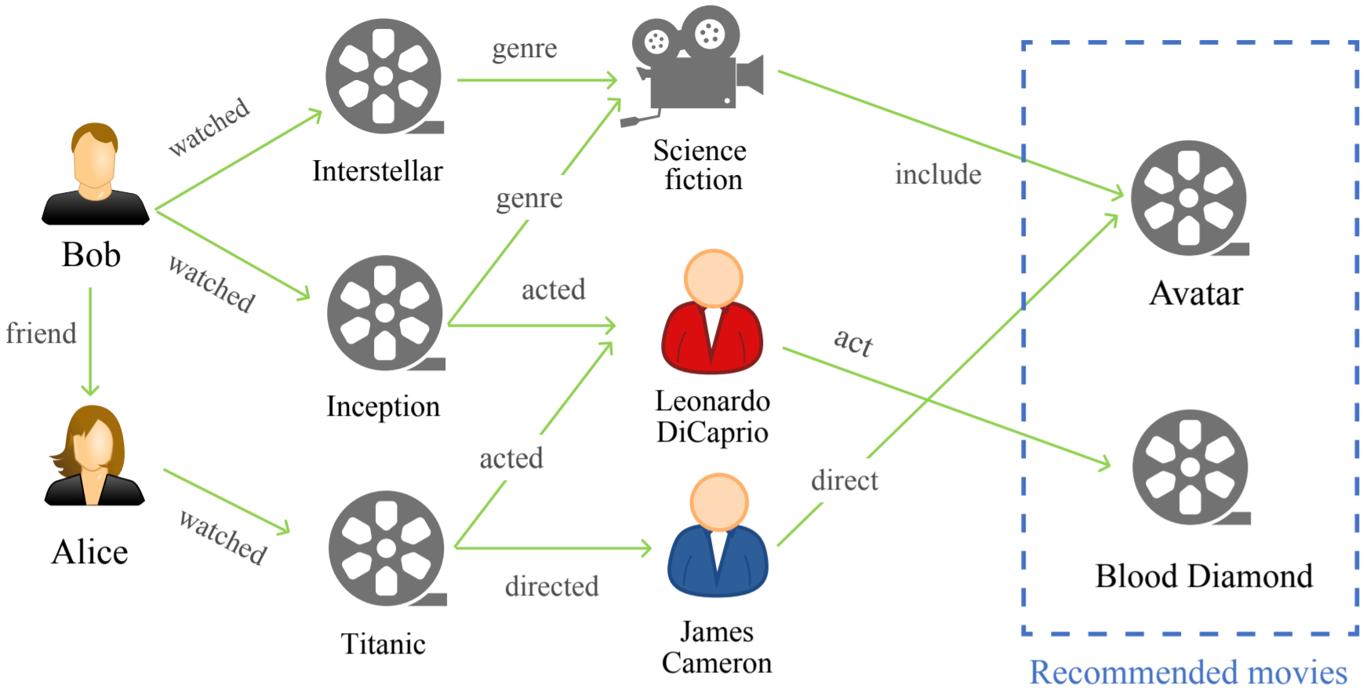
Graphs are everywhere
Computer networks
Social networks
Fintech
Source: https://commons.wikimedia.org/wiki/
File:Internet_map_4096.png
Source: https://commons.wikimedia.org/wiki/
File:Social_Network_Analysis_Visualization.png
Source:https://commons.wikimedia.org/wiki/ File:Relationship_graph_of_Panama_Papers.png
Neural networks/AI
Commerce/Recommendations
Source: https://pixabay.com/get/
57e7d2404350ae14f6da8c7dda3536781538d6e25b55794f_1280.jpg
Source: https://arxiv.org/pdf/2003.00911v1.pdf

Slide 29
Graphs are hard
Expressiveness at a cost
  Complex queries
    Traversals (e.g., BFS, DFS, …)
    Routing (e.g., A* search, SSSP, APSP, …)
    Network analysis (e.g., centrality, PageRank, …)
    Graph pattern matching (e.g., subgraph isomorphism, approximate pattern matching, …)
Unique access patterns
  Large number of data accesses
  Low spatial locality
Often restrictive application domains/use cases

Slide 30
Case study 3: Subgraph Matching

Slide 31
Example: Subgraph/supergraph queries
graph dataset
graph dataset
subgraph queries
B
B
B
B
B
B
A
B
A
B
A
B
A
B
B
A
B
A
B
C
D
D
C
D
D
A
B
graph dataset
B
B
D
query
B
supergraph queries
A
B
A
B
A
B
D
C
D

Slide 32
Bruteforce Approach
q
g1
g2
g3
g4
g5
g6
g7
q
q
g1
g1
Subgraph isomorphism test
q
q
g2
g2
NP complete
q
q
g3
g3
q
q
g4
g4
… works, but highly inefficient …
q
q
g5
g5
q
q
g6
g6
q
q
g7
g7

Slide 33
Index-based processing (Method M)
g1
g2
g3
g4
g5
q
g1
q
g1
Subgraph
isomorphism
test
q
g2
Candidate Set
q
g2
q
g3
q
g3
q
g4
q
g4
q
Dataset Index
q
g5
q
g5
g1
g2
g3
g4
g5
g6
g7
g1
g2
g3
g4
g5
g6
g7
F. Katsarou, N. Ntarmos, and P. Triantafillou, “Performance and Scalability of Indexed Subgraph Query Processing Methods,” Proceedings of the VLDB Endowment (PVLDB), vol. 8, no. 12, pp. 1566–1577, 2015.
F. Katsarou, N. Ntarmos, and P. Triantafillou, “Hybrid Algorithms for Subgraph Pattern Queries in Graph Databases,” in Proceedings of the IEEE International Conference on Big Data (BigData), 2017.
F. Katsarou, N. Ntarmos, and P. Triantafillou, “Subgraph Querying with Parallel Use of Query Rewritings and Alternative Algorithms,” in Proceedings of the 20th International Conference on Extending Database Technology (EDBT), 2017.

Slide 34
… meanwhile, in the real world ...
worldwide friendship network
friendship network in Europe
friendship network in UK
friendship network in Glasgow
Let’s harness these subgraph/supergraph relationships among queries!
proteins of multi-cell organism, e.g., plants, animals
friendship network in U of G
proteins of uni-cell bacteria
protein mixtures
proteins
amino acids

Slide 35
Enter the GraphCache

Slide 36
Enter the GraphCache
Candidate Set (CS)
{g1, g2, g3, g4, g5}
YES
TBD
NO
GC
g1
g2
g3
g4
g5
Method M
g1
g2
g3
g4
g5
Bruteforce approach
g1
g2
g3
g4
g5
g6
g7
J. Wang, N. Ntarmos, and P. Triantafillou, “Indexing Query Graphs to Speed Up Graph Query Processing,” in Proc. EDBT, 2016.
J. Wang, N. Ntarmos, and P. Triantafillou, “GraphCache: A Caching System for Graph Queries,” in Proc. EDBT, 2017.
J. Wang, N. Ntarmos, and P. Triantafillou, “Ensuring Consistency in Graph Cache for Graph-Pattern Queries,” in Proc. GraphQ, 2017.
J. Wang, Z. Liu, S. Ma, N. Ntarmos, and P. Triantafillou, “GC: A Graph Caching System for Subgraph/Supergraph Queries,” PVLDB, 11(12):2022–2025, 2018.

Slide 37
GraphCache
Query Index
q1
q2
q3
q4
q5
q6
q7
Answer sets
Metadata
…
…
…
…
…
…
{g1, g2}
…
…
…
…
…
{g1, g2, g3, g4, g7}
…

Slide 38
Sub case: q is a subgraph of a previous query
Dataset Index
Method M
filtering
g1
g2
g3
g4
g5
CS
q
YES
g1
g2
g3
g4
g5
g1
g2
g1
g2
Why remove g1, g2 from CS ?
q1
q2
q3
q4
q5
q6
q7
q1
q2
q3
q4
q5
q6
q7
A(q4): {g1, g2}
q4
(answer set)
Query Index
Query Index
Query Index

Slide 39
Sub case (cont.): q is a subgraph of multiple previous queries
A(q2) ∪ A(q4) ∪ A(q6)
YES
YES
q
A(q2)
A(q4)
A(q6)
Answer sets
q1
q2
q3
q4
q5
q6
q7
Query Index

Slide 40
Sub case (cont.): ... a special case
Answer set of q (against dataset) = A(q2)
A(q2)
q isomorphic to q2 (“same” query found)
q
q2
q1
q2
q3
q4
q5
q6
q7
Query Index

Slide 41
Super case: q is a supergraph of a previous query
Dataset Index
Method M
filtering
g1
g2
g3
g4
g5
CS
q
g1
g2
g3
g4
g5
NO
g7
g3
g4
g7
g1
g2
g3
g4
g1
g2
q1
q2
q3
q4
q5
Why remove g5 from CS ?
q1
q2
q3
q4
q5
q6
q7
q7
q6
q7
{g1, g2, g3, g4, g7}
(answer set)
Query Index
Query Index
Query Index

Slide 42
Super case (cont.): q is a supergraph of multiple previous queries
NO
CS – {CS ∩ A(q5) ∩ A(q7)}
Not in
A(q5) ∩ A(q7)
q
A(q5) ∩ A(q7)
A(q5) ∩ A(q7)
Answer sets
A(q5)
A(q7)
q1
q2
q3
q4
q5
q6
q7
Query Index

Slide 43
Super case (const): … a special case
No dataset graph could contain q
No dataset graph contains q7
q
A(q7) = { }
q7
q1
q2
q3
q4
q5
q6
q7
Query Index

Slide 44
Putting it all together…
Dataset Index
Method M
filtering
g1
g2
g3
g4
g5
Sub case
q
g1
g2
g3
g3
g4
g4
g5
g5
Super case
g3
g3
g4
g4
g5
g7
g1
g2
g1
g3
g2
g4
Query Index (Sub case)
Query Index (Super case)

Slide 45
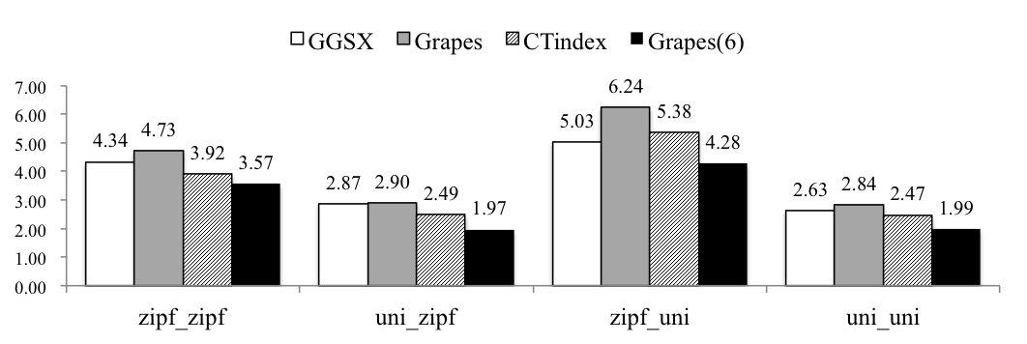
Performance Results
Query processing time speedup
F. Katsarou, N. Ntarmos, and P. Triantafillou, “Performance and Scalability of Indexed Subgraph Query Processing Methods.” PVLDB, 8(12):1566-1577, 2015.
J. Wang, N. Ntarmos, and P. Triantafillou, “Towards a Subgraph/Supergraph Cached Query-Graph Index.” IEEE BigData 2015.
J. Wang, N. Ntarmos, and P. Triantafillou. “Indexing Query Graphs to Speed Up Graph Query Processing.” EDBT 2016.

Slide 46
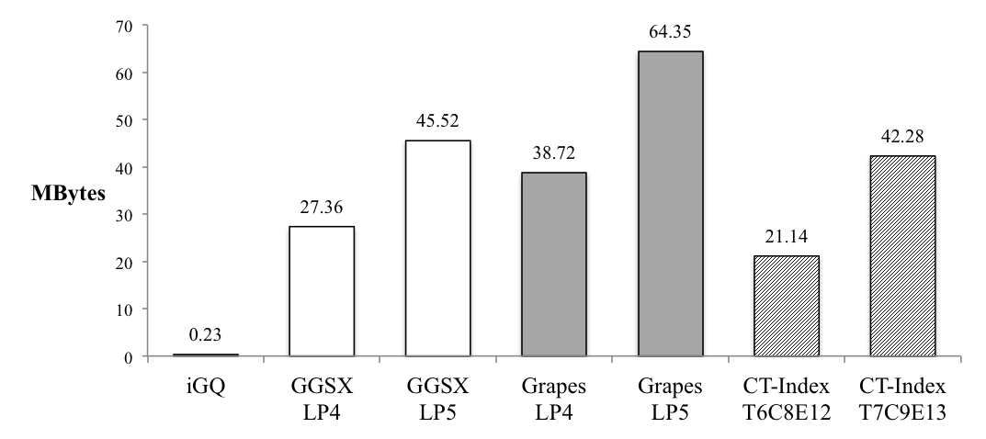
Performance Results
iGQ speedup = ~2X - ~40X
speedup < 1.1
~ 1% space increase
~ 100% space increase
Index Size

Slide 47
(Graph) Database Systems Research @ Huawei ERC

Slide 48


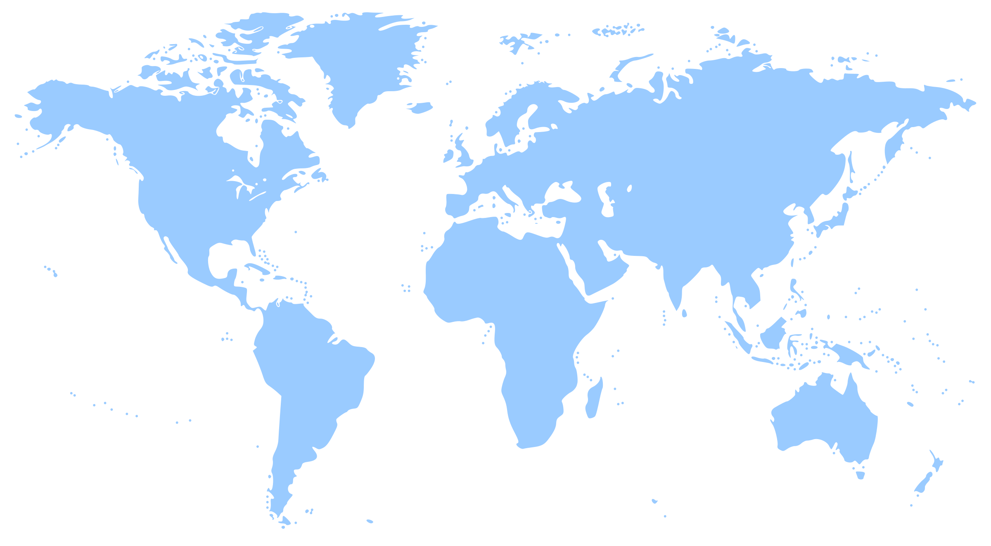
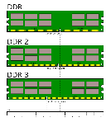

Graph Database Lab @ Huawei ERC
Building the Next Generation of Graph Database Management Systems
In-memory transactional graph databases
Concurrent data structures and parallel algorithms for multi-core multi-socket parallelism
Graph-native in-memory transactional storage
Hardware accelerated ingestion + processing
Distributed transactional graph databases
Distributed transactional storage meets high performance distributed graph processing
For both bare-metal (high performance, scalability and fault tolerance) and cloud-native (elasticity, automation, ease of use)

Slide 49
Graph Database Challenges
In-memory graph DBs
  Need for speed: High (inter+intra-query) parallelism + NUMA/SIMD/CPU cache friendliness/…
  Minimal memory footprint
ACID transactional guarantees
  Revisiting fundamental trade-offs
HTAP capabilities
  Convergence of transactional graph databases and graph processing frameworks

Slide 50
Graph Database Challenges
Graph databases on modern hardware
  NVM / RDMA / HTM / Hardware acceleration /…
Graph databases on application-specific hardware
  Non-intel CPUs
  Different memory model/execution unit/ISA/cache characteristics
Graph databases on virtualised hardware
  Cloud-native
  Elasticity
  Transactionality

Slide 51
Graph Database Challenges
Efficient graph queries over intermediate graph results
  Active Semantic Caching
  Query rewriting using (non-)materialised views
Graph-aware query optimisation
  Structure+property queries
  Graph+memory+hardware topology-aware query processing
  Worst-case optimal algorithms
  Plan enumeration + cost estimation
  Incremental query processing
  Multi-query optimisation
  Code generation

Slide 52
Graph Database Challenges
Distributed graph DBs
  Graph partitioning + consistency at scale
  Formal verification
  Query processing + optimisation
Query language
  GQL standardisation efforts
  Domain and application-specific extensions
In-database AI
  Machine learning
  Reasoning + inference
AI-enabled database kernel
  Cost/cardinality estimation
  Approximate query processing
  Data-driven query result caching

Slide 53


